Slide 1
Customer Segmentation
Final Project by Abijith Suresh & Vaishnavi

Slide 2
Attributes
People
Product
Promotion
Place
ID
Year Birth
Marital Status
Income
Kidhome
Teenhome
Dt Customer
Recency
Complain
NumDealsPurchases
AcceptedCmp1
AcceptedCmp2
AcceptedCmp4
AcceptedCmp5
AcceptedCmp5
Response
NumWebPurchases
NumCatalogPurchases
NumStorePurchases
NumWebVisitsMonth
MntWines
MntFruits
MntMeatproducts
MntFishProducts
MntSweetProducts
MntGoldProds

Slide 3
PROBLEM STATEMENT:
A thorough examination of a business's ideal client is known as a customer personality study. A corporation may more easily adapt products to the unique needs, behaviors, and concerns of various client types when it has a deeper understanding of its consumer base.
A company can make adjustments based on its target customers from various customer segments with the aid of customer personality analysis. For instance, a business can analyze which customer segment is most likely to purchase the product and then market the product exclusively to that specific segment rather than spending money marketing a new product to every client in the company's database.

Slide 4
DATA COLLECTION

Slide 5
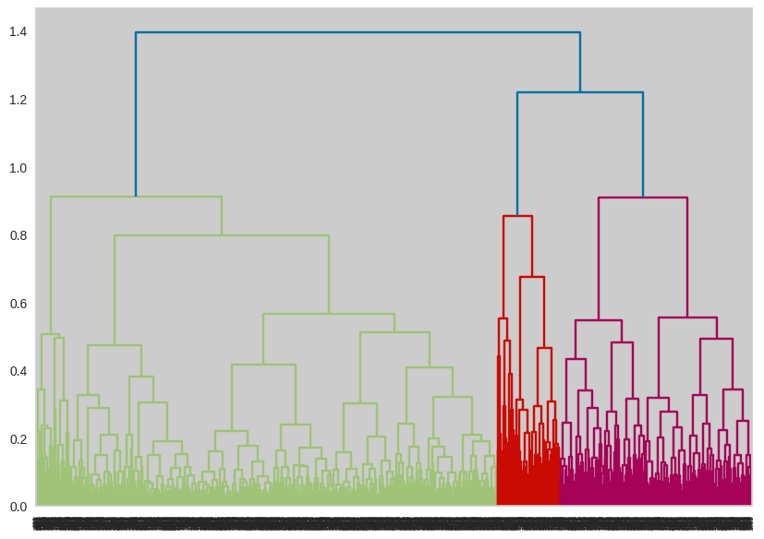
EDA :
Exporatory data analysis (EDA) is an approach that is used to analyze the data and discover patterns,
or check assumptions in data with the help of statistical summeries and graphical representation;
it can also helps determine if the statistical techniques you are considering for data analysis are apporiate

Slide 6
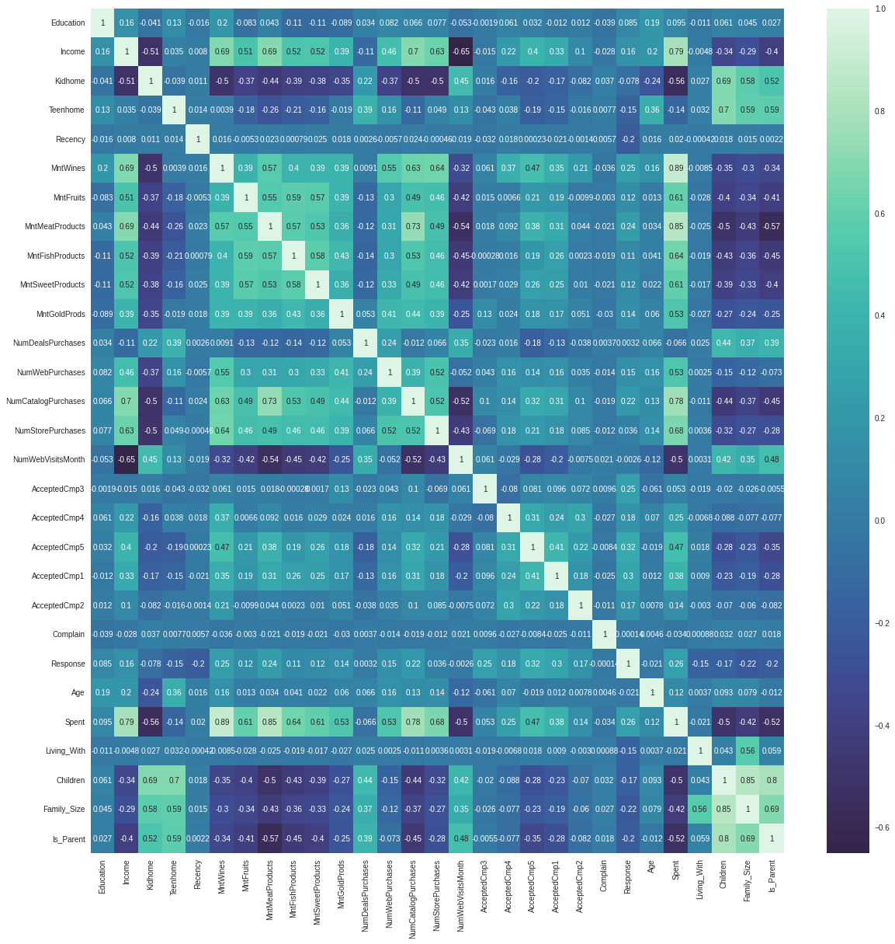
CORRELATION MATRIX :
Correlation Matrix

Slide 7
CLUSTERING:
To find groupings of related objects in a dataset containing two or more variable
quantities, clustering is utilized. Data points are grouped into clusters with the help of clustering techniques like hierarchical, partitioning, density-based, model-based, and grid-based models. These strategies employ a variety of approaches to identify the best solution for the given situation. Compared to data objects in other clusters, clusters are more loosely defined within their own cluster.

Slide 8
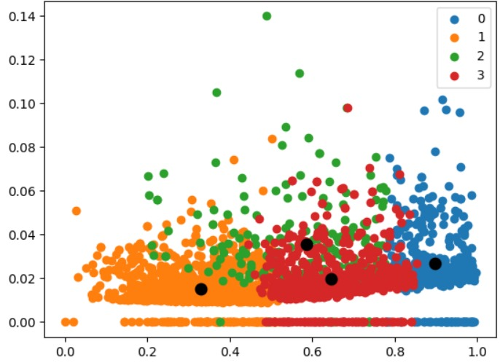
K - MEANS
K-means clustering is an unsupervised machine learning algorithm that partitions a dataset into a predefined number of clusters. It works by iteratively assigning data points to clusters based on their proximity to cluster centroids and updating centroids based on the mean of points assigned to each cluster. The goal is to minimize the within-cluster variation.

Slide 9
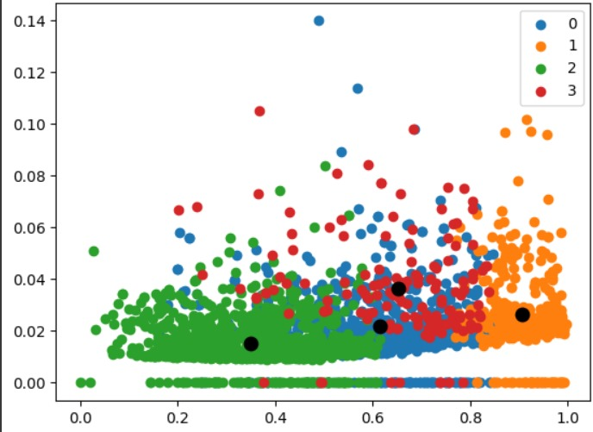
HIERARCHICAL CLUSTERING
Hierarchical clustering is a method of grouping similar data points into clusters by creating a hierarchy of clusters. It can be either agglomerative (bottom-up) or divisive (top-down). In agglomerative clustering, each data point starts as its own cluster, and pairs of clusters are merged iteratively based on similarity until all data points belong to one cluster. Divisive clustering starts with all data points in one cluster and splits them into smaller clusters iteratively. Hierarchical clustering does not require specifying the number of clusters beforehand and generates a dendrogram to visualize the clustering structure.

Slide 10
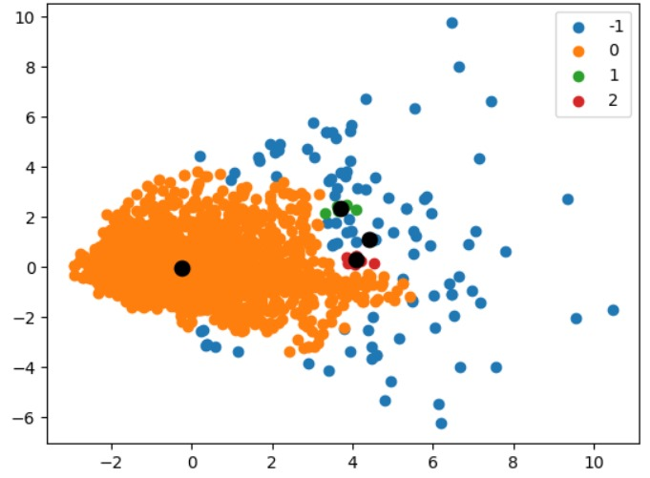
DBSCAN CLUSTERING
DBSCAN (Density-Based Spatial Clustering of Applications with Noise) is a clustering algorithm that groups data points based on their density. It identifies clusters as areas of high density separated by areas of low density. Unlike K-means, it does not require specifying the number of clusters beforehand and can handle clusters of arbitrary shapes. DBSCAN classifies points as core, border, or noise points, and it is robust to outliers.

Slide 11
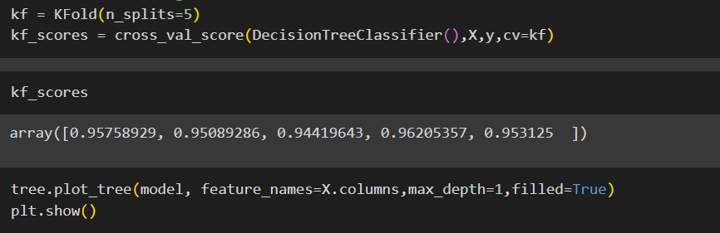
Decision Tree Using K fold:

Slide 12
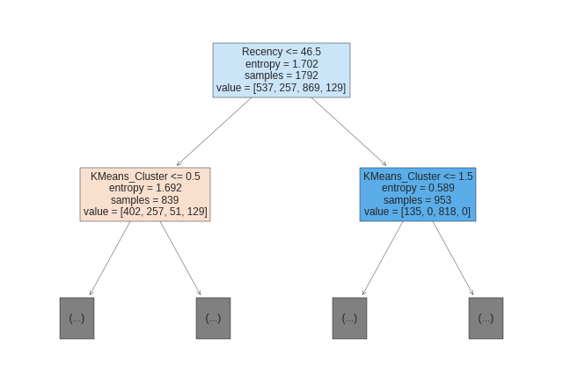

Slide 13
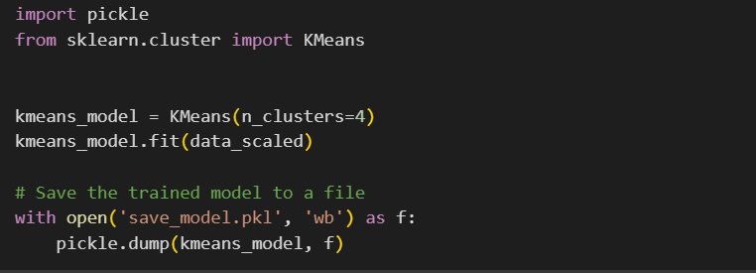
DEPLOYMENT:

Slide 14
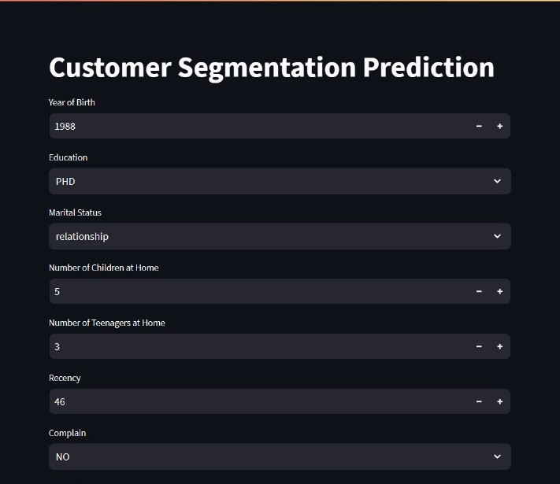

Slide 15
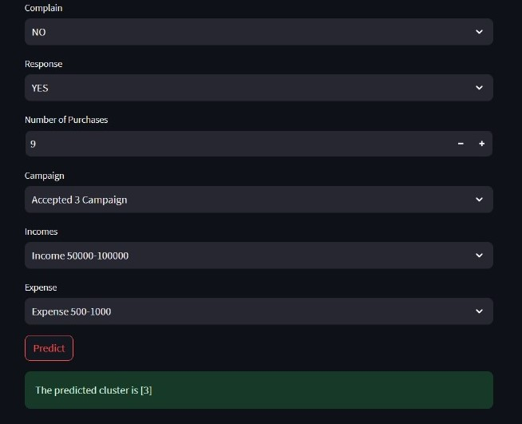

Slide 16
CONCLUSION:
Customer segmentation is one the most important application of unsupervised learning. With the help of clustering technique ,B2C(Business to customers) companies can identify the several segments of customers that share a similarity in different ways that are relevant to marketing such as income, marital status, teehome and miscellaneous spending habits. This will allow them to target the potential user base.
in this Data Science project, we will perform one of the most essential application of machine learning- customer segmentation. In this project, we will implement customer segmentation in python. Whenever you need to find your best customer , customer segmentation is the ideal methodology.

Slide 17
Thank You

